Slide 1
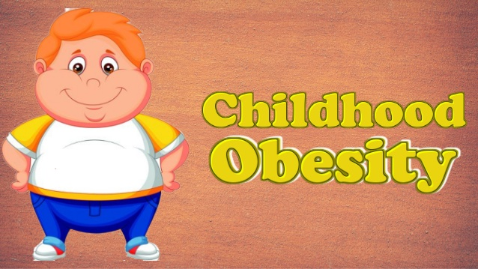
Dealing with Obesity in Children
Institution:
Course:
Name:

Slide 2
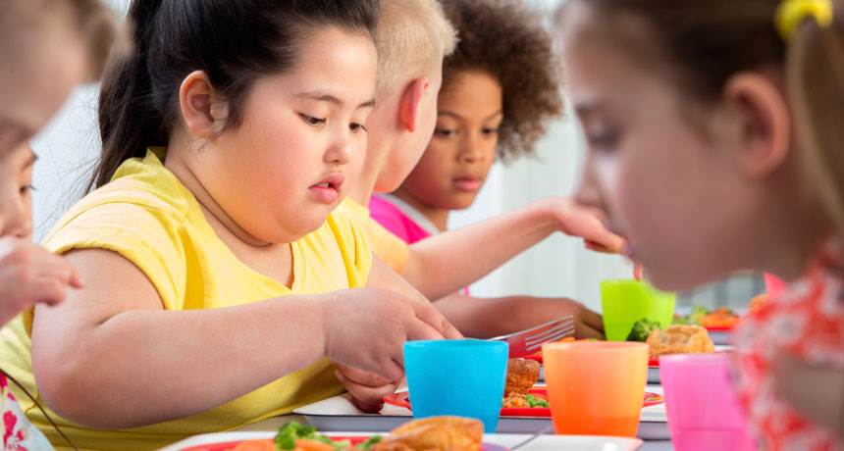
Introduction
Obesity amongst the children has become a major societal concern.
The issue is being experienced in both developing and developed nations.
More than a hundred million kids across the world are overweight.
Obesity has been categorized as an “epidemic” since it is now a characteristic of populations.
In America, obesity has progressively increased.
Notes:
Obesity amongst the children and adolescents has become a major concern within the society. the issue of obesity is not only facing the developed countries but also the developing countries across the globe. There are more than 100 million children who are overweight across the world. Obesity has been categorized as an “epidemic” because it is not a characteristic of populations and individuals. In addition, obesity seems to have progressively increased in the United States of America leading to a major public health challenge (Sonya and Guitlaume 14).

Slide 3

Fixing this Ethical Issue
Government oversight and intervention into the issue.
Enhance parental responsibility.
Increase media literacy.
Kids will be able to navigate through media marketing strategies.
Representatives from food and beverage organizations, medical and nutrition experts , advertising reps and consumer groups met to discuss on industry self-regulation.
Notes:
In order to fix the ethical issues surrounding obesity, one of the measures that need to be taken up is that of increasing parental responsibility. Parents should be held responsible for their children’s obesity – they are required to offer advice or to give their children foods that will be less likely to cause obesity. The government should also take part in this issue by providing directions with regard to commercial ads dealing with fast-food (Sonya et al., 14). Children should be taught about the media and how it operates. They will result in gaining knowledge that will enable them to make sound decisions with regard to the commercial ads showing fast-foods. In addition, there has been organized meetings where reps from consumer groups, advertising, nutrition and medical experts and food and beverage organizations where they discussed about the industry self-regulation.

Slide 4
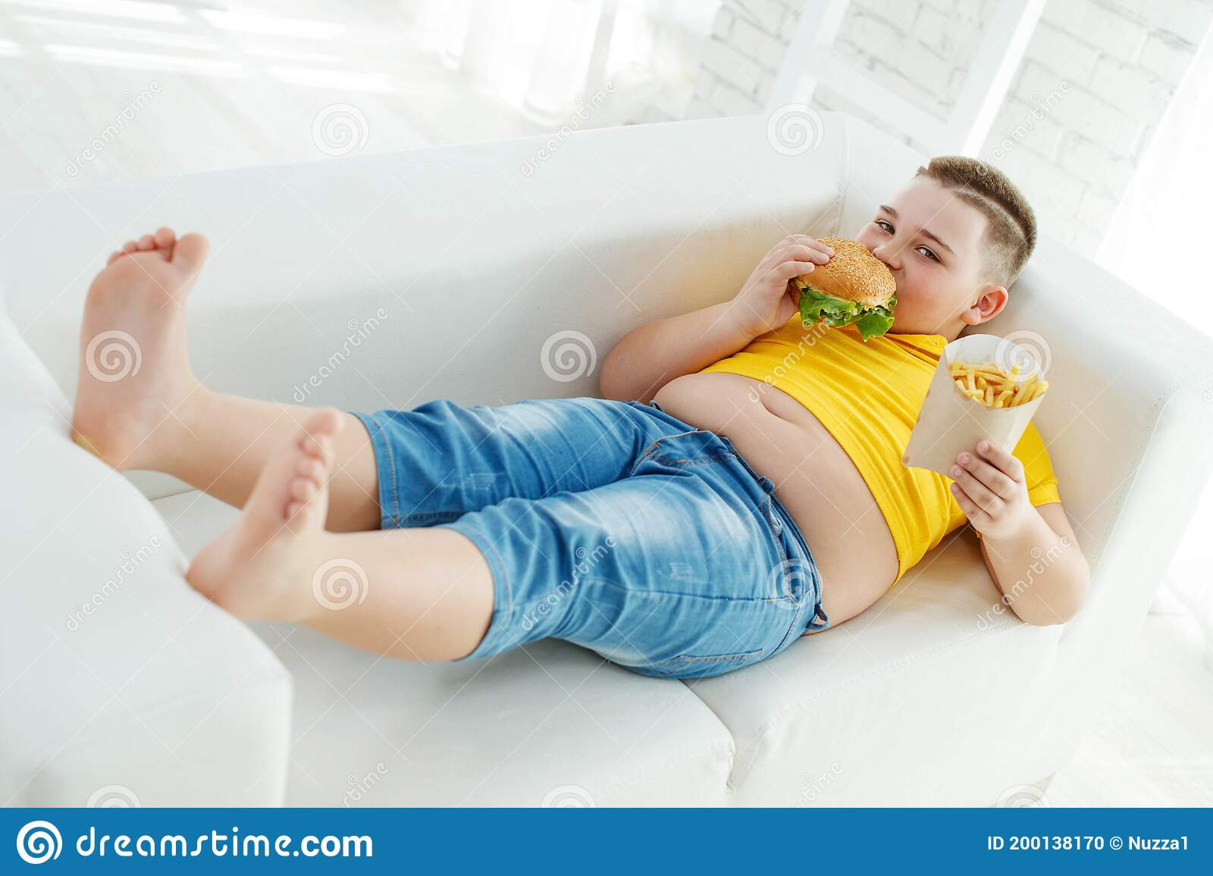
Steps Taken to Counteract Obesity
The FTC, the Federal government as well as other government agencies have carried out hearing about the issue of obesity in children.
They have handed over reports about obesity in children.
The launch of the Children’s Food and Beverage Advertising Initiative.
This initiative ensures transparency and accountability in advertisements.
Companies are required to be sincere and not direct information targeting certain ethnicity.
Notes:
There are various issues that have been taken up by various partners in order to resolve the issue of obesity in children. The federal government, the FTC and some other governmental agencies have conducted hearing regarding the issue of obesity in children and issued reports on their findings. Companies have also come together and launched the Children’s Food and Beverage Advertising Initiative that has been geared towards addressing the issue of misleading food ads. This initiative is geared towards ensuring transparency as well as accountability in all fast-food organizations (Sonya , et al., 14). Some companies have been carrying out their ads which have been versioned to attract members of a certain ethnicity. For instance, the fast-food companies have been running ads which are meant to attract teens from the African-American ethnicity.

Slide 5

Social Responsibilities of Companies & how Unhealthy the Food Really is
CFBAI is meant to shift the mix of ads to encourage healthy dietary choices.
Some organization have integrated societal concerns about obesity into their CSR.
Examples; Kraft Foods, Pepsi.
They have come up with information that is meant to cultivate consumers’ trust and brand.
Notes:
The CFBAI has been put in place by different food companies in order to encourage the players operating within the food industry to offer information about healthy dietary choices. Some organizations have integrated societal concerns about obesity in their corporate social responsibilities. Examples of such businesses include Kraft Food and Pepsi. They have decided to come up with information that is geared towards cultivating for consumer’s trust and brand (Sonya, et al., 15).

Slide 6
Work Cited
Sonya, A., Grier and D., Johnson Guitlaume. "'Alisha in Obesity-land' Is Food Marketing the Mad Hatter?" The Dark Side 2: Critical Cases on the Downside of Management (2010): 1-21.

